Slide 1


Controlling Volume with Hand Gestures using a Webcam
Presented by:-
SNEHIL GHOSH
AMRUTHA VERSHINI GARI
GAUTAM N CHIPKAR
AYUSH GORGE
Mentor: Dr. D. Bhanu Prakash

Slide 2
Project Statement
Building a computer vision-based application that enables users to
control their system volume using predefined hand gestures.
By detecting hand landmarks from a webcam feed using MediaPipe and
interpreting the geometric relationships between them, the application
translates specific gestures (such as pinch distance ) into volume
control signals.
The System eliminates the need for physical contact, making it suitable
for smart environments, assistive technology, and touch-free control
systems.

Slide 3
Expected outcome
Expected Outcomes:-
Processes real-time webcam input
Detects hand landmarks (MediaPipe Hands)
Classifies gestures (thumb-index distance)
Maps gesture to system volume levels
Optional: small schematic diagram showing webcam → MediaPipe → Volume Control.

Slide 4

Setup
OpenCV (cv2)
Library for real-time computer vision, used to:
Access webcam frames
Convert BGR ↔ RGB images
Draw overlays (landmarks, markers, text)
Perform frame processing at high FPS
MediaPipe Hands
Google’s ML framework for hand tracking, used to:
Detect hands in webcam feed
Track 21 hand landmarks
Extract gesture-related measurements (finger count, distances, aspect ratio)
Provide stable real-time gesture recognition
NumPy
Fundamental library for numerical computation, used to:
Calculate distances & interpolations
Handle arrays of frame metrics
Compute scaling, aspect ratios and smoothing metrics
Matplotlib
Visualisation library used inside the Tkinter HUD to:
Draw Arc-Reactor styled polar volume meter
Render Z-axis proximity bar
Plot real-time graphs (Norm distance, Pixel distance, Aspect ratio)
Update displays at runtime with .draw_idle()

Slide 5
Setup
Tkinter
Python’s built-in GUI framework, responsible for:
Main application window
HUD layout structure
Video preview rendering
Embedding Matplotlib graphs
Responsive UI and status updates
PIL / Pillow
Image processing library used to:
Convert NumPy arrays → Tkinter-compatible images
Resize frames with LANCZOS filtering
Support smooth rendering of webcam preview
Pycaw (Python Core Audio Windows Library): Key library enabling microphone volume control:
Interfaces with Windows Audio Session API (WASAPI)
Gets/sets microphone volume level
Handles mute/unmute functionality
Requires COM interaction → moved into child process for stability
Comtypes (COM Interface Library)
Used for interacting with Windows COM components:
Activates audio endpoint (microphone)
Communicates with IAudioEndpointVolume
Requires strict threading (reason for child subprocess isolation)

Slide 6
Setup
Subprocess (child_mic_server.py)
A dedicated child process used to:
Offload all COM+pycaw operations
Prevent threading issues in notebook/Tkinter
Communicate with main program via stdin/stdout commands
Maintain system stability
threading & queue
Used to handle asynchronous tasks:
Background threads for reading subprocess output
Non-blocking queues for safe communication
Ensures UI thread stays responsive
Jupyter Notebook (Development Environment)
Used during development for:
Testing MediaPipe outputs
Plotting and debugging graphs
Iterative experimentation with frame processing
Easy visualisation and step-by-step execution
Windows OS (Mandatory for pycaw)
Pycaw and WASAPI are Windows-exclusive. Thus, the entire mic-control module requires Windows 10+.

Slide 7
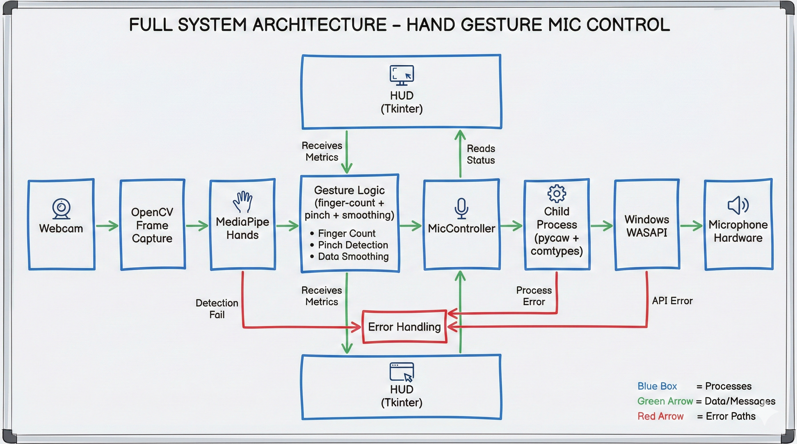
Full System Architecture

Slide 8
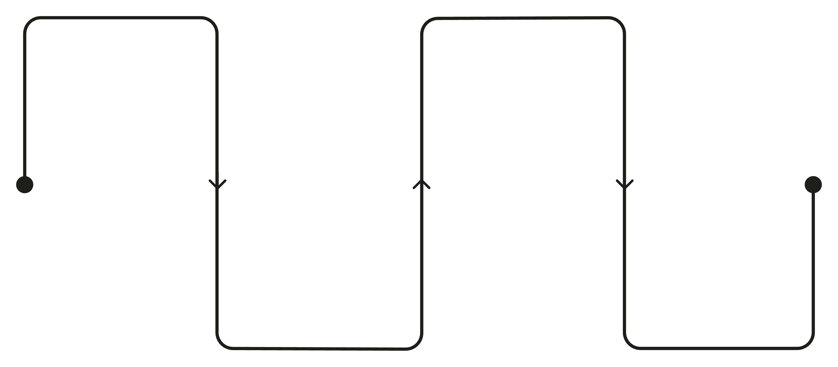
MediaPipe Two-Stage Architecture
MediaPipe Hands does not rely on a single, monolithic CNN for hand tracking. Instead, it employs two distinct, task-optimized convolutional neural networks arranged in a sequential pipeline. This architectural decision stems from a fundamental insight: detecting the presence and location of a hand is a fundamentally different computational problem than precisely localizing individual finger joints and articulation points.
STAGE 1: PALM DETECTION
STAGE 2: LANDMARK REGREATION
MediaPipe Hands: Two-Stage Pipeline
Hand (Palm) Detection Stage
Detects presence of a hand
Outputs a bounding box
Hand Landmark Detection Stage
Predicts 21 hand landmarks
Provides precise finger joint positions
Optimized for real-time execution
Runs efficiently on CPU
Binary detection + bounding box
Predict 21 precise hand landmarks
TRANSITION
BENEFITS
Crop ROI and pass to regressor
Accuracy, efficiency, speed, stability

Slide 9
Deep Learning Network
The system uses specialized Deep Learning Networks (DLNs) for real-time hand gesture recognition
Instead of a single generic model, task-specific Convolutional Neural Networks (CNNs) are employed
These CNNs are optimized for:
Speed
Accuracy
Real-time execution on CPU
MediaPipe follows a two-stage deep learning approach:
Hand (Palm) Detection
Hand Landmark Estimation
This design ensures efficient, stable, and precise gesture interpretation

Slide 10
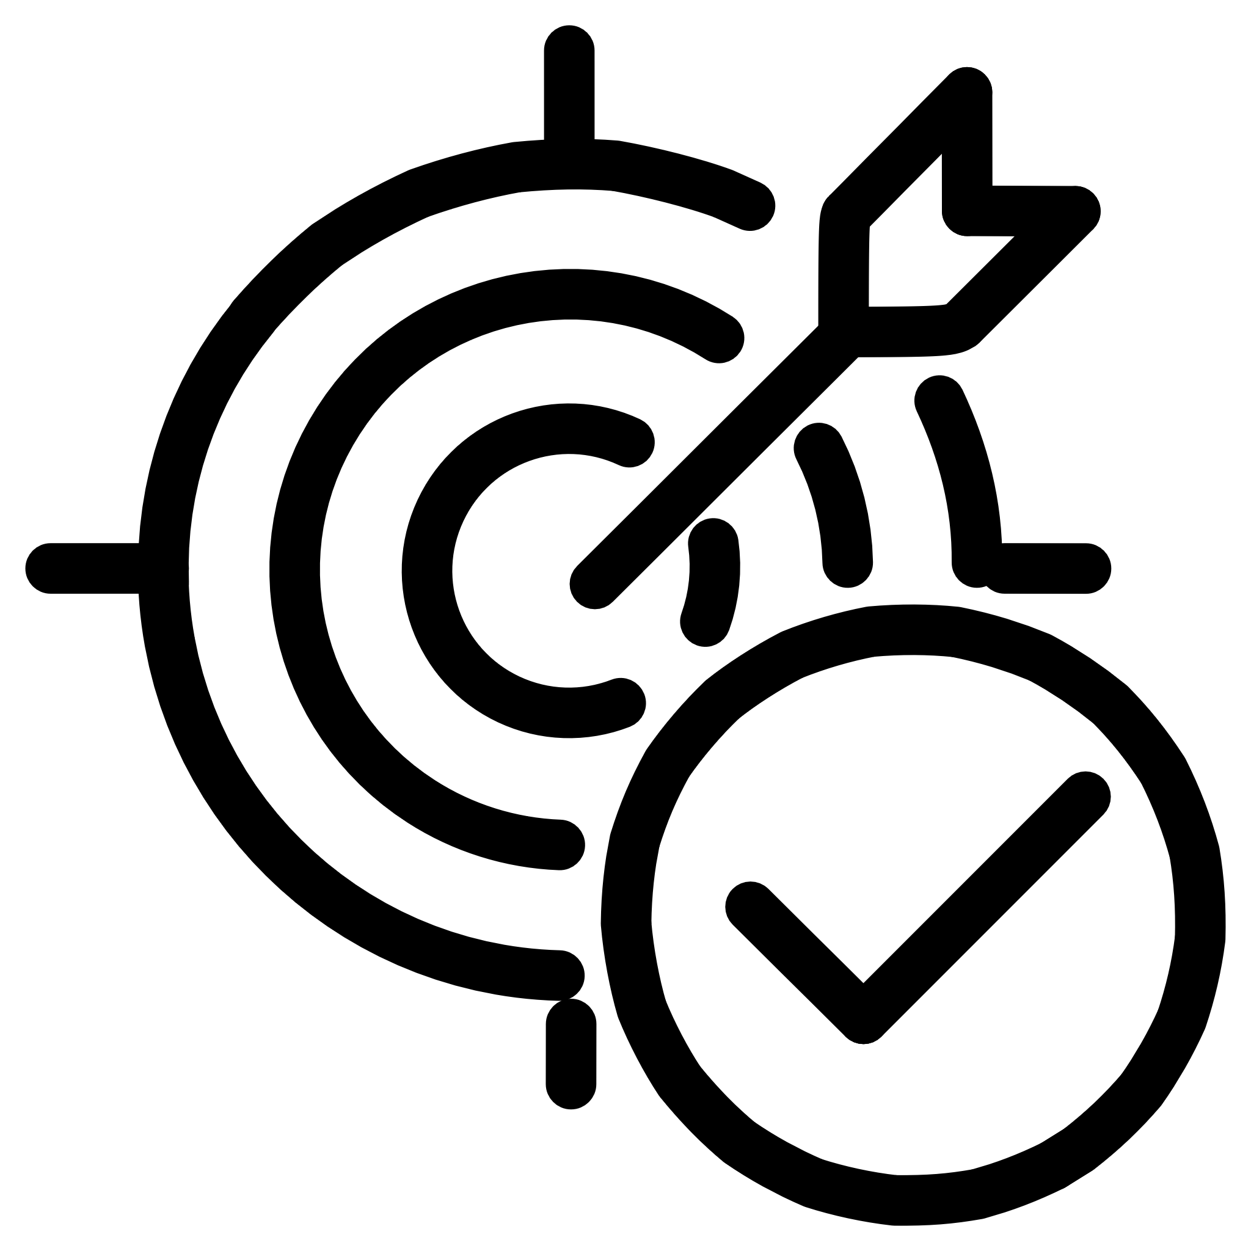




CNN 1: PALM DETECTION
STAGE 1- HAND PRESENCE DETECTION
CORE CONCEPTS
ARCHITECTURE FOUNDATION
The palm detection network answers a binary spatial question: "Is there a hand in this frame, and where is it?" This network intentionally ignores finger articulation, joint positions, and gesture details. Its sole responsibility is to establish hand existence and provide a rough bounding box.
Built on Single Shot Detector (SSD) architecture, this is a specialized object detection CNN, not a classification network. SSD architecture enables detection in one forward pass, eliminating expensive region proposal stages found in architectures like Faster R-CNN.
SINGLE FORWARD PASS
REAL-TIME PERFORMANCE
ROTATING INVARIANT
Outputs bounding box coordinates and confidence score in one inference cycle
Low latency on CPU, optimized for continuous video frame processing
Robust detection regardless of hand orientation or scale variations
1
PALM BOUNDING BOX OUTPUT
2
SSSD ARCHITECTURE
3
FULL FRAME INPUT

Slide 11
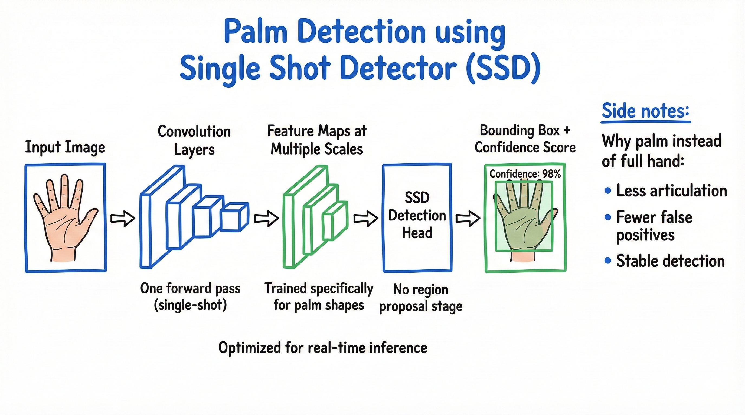
VISUAL ARCHITECTURE

Slide 12



CNN 2: HAND LANDMARK DETECTION
STAGE 2- FINE GRAINED HAND UNDERSTANDING
Once the palm detection network establishes hand presence and location, the second network tackles a significantly more challenging problem: precise localization of 21 anatomical landmarks across the hand structure. This requires a fundamentally different neural architecture and computational approach.
ARCHITECTURAL TYPE
PREDICTION TARGET
LANDMARK COVERAGE
Regression-based Convolutional Neural Network
21 Hand Landmarks × 3 Coordinates = 63 Total Outputs
Complete Hand Skeleton
This is not a detection network. This is not a classification network. This is a regression network that predicts continuous coordinate values for each landmark point.
Includes finger joints (metacarpophalangeal, proximal interphalangeal, distal interphalangeal), fingertips, wrist position, and relative depth information.
For each landmark, the network predicts X (horizontal position), Y (vertical position), and Z (relative depth from camera plane).
1
21 LANDMARKS WITH X,Y,Z COORDINATES
2
COORDINATE PREDICTION
3
REGRESSION NETWORK PROCESSING
4
CROPPED ROI INPUT

Slide 13
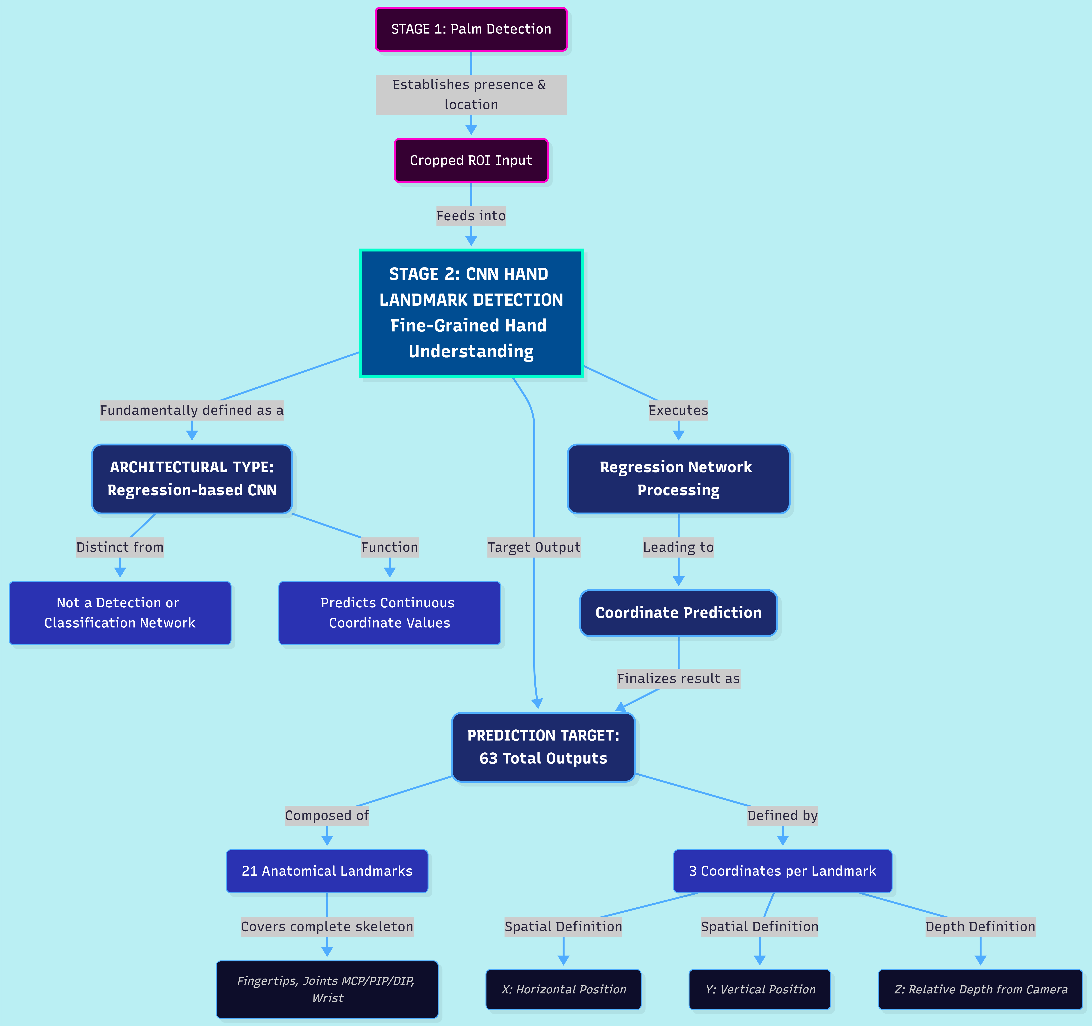

Slide 14
System Configuration (End-User)
Minimum Supported Configuration
OS: Windows 10
Processor: Dual-core CPU
RAM: 4 GB
Webcam: Basic 480p (reduced accuracy)
No GPU required
⚠️ Performance may degrade under low light
Recommended System Configuration
OS: Windows 10 / 11 (64-bit)
Processor: Intel i5 / Ryzen 5 or higher
RAM: 8 GB minimum
Camera: Integrated or USB webcam (720p+)
Microphone: Any WASAPI-compatible mic
Python Environment (bundled in exe)

Slide 15
OpenCV Helps in Gesture Recognition
OpenCV is the vision engine of your project. It does not understand gestures by itself — but it provides the raw visual data pipeline required for MediaPipe to do its work.
Think of it as the camera operator in a movie production.
✅ What OpenCV actually does conceptually
Accesses real-time webcam feed
Opens the hardware stream
Manages frame-by-frame extraction
Handles camera drivers, buffering, and performance
Delivers clean frames for processing
Flips the image (mirror view)
Converts BGR → RGB (required by MediaPipe)
Resizes or normalizes if needed
3. Provides a stable, constant-speed video loop
Ensures every frame reaches the hand-detection model
Maintains 20–30 FPS so gesture detection feels instant
4. Acts as the visual “world interface”
Without OpenCV, MediaPipe has nothing to analyse
It is the bridge between hardware → AI model

Slide 16
How Audio APIs Help in Gesture
Where OpenCV is the eyes, Pycaw/WASAPI serves as the hands that control the microphone.
Gesture detection alone is useless unless it can change something in the system. That “something” is the microphone input volume.
✔️ What the Audio API does conceptually
Provides access to the Windows Audio Stack (WASAPI)
WASAPI controls hardware input/output
Pycaw exposes this through Python
You get a handle to the default microphone endpoint
2. Lets you read/write microphone volume safely
GetMasterVolumeLevelScalar() → Read current %
SetMasterVolumeLevelScalar() → Apply new %
3. Allows full control with zero UI interactions
No need to open Windows Sound Panel
No need to change OS settings manually
4. Integrates seamlessly with gesture output
Gesture value (0–5) → Volume % (0–100)
Pinch → Fine control using pixel distance
Open palm → High volume
Closed hand → Mute/Low volume
5. COM stability ensures accurate, real-time volume updates
That’s why the child process is used
COM must run in a dedicated, single-threaded environment

Slide 17
Input vs Output Audio Devices
Audio Device Classification in WASAPI
Input Device — eCapture
Represents microphone devices
Used for voice input and recording
Controlled using IAudioEndpointVolume
Output Device — eRender
Represents speakers / headphones
Used for system audio playback
Why eCapture in Our Project
Gesture maps to microphone gain
Not system speaker volume
Required for conferencing & assistive use cases
Windows Audio Endpoints (WASAPI)
eRender
Represents audio output devices
Examples: speakers, headphones
Used for system sound playback
eConsole
Represents default user-facing audio path
Optimized for real-time interaction
Common for voice calls and system audio routing
Endpoint Role in WASAPI
Logical abstraction over physical hardware
Allows software-level control without UI interaction

Slide 18
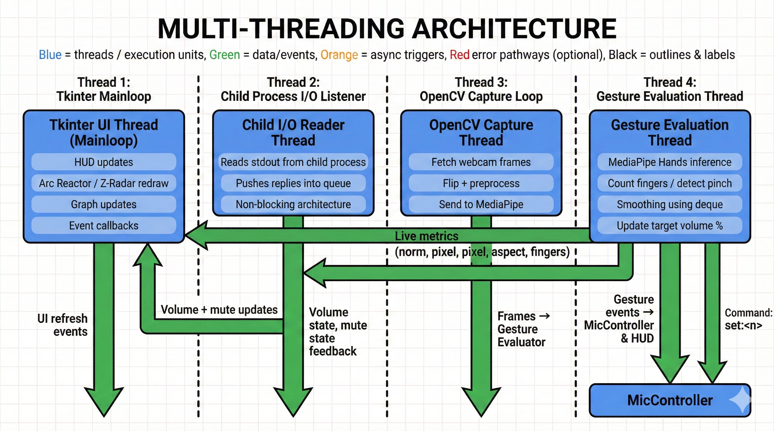
Multi-threading Architecture
Threads involved:
Tkinter mainloop
Child process I/O reader
Hotkey listener
OpenCV camera capture
Gesture evaluation

Slide 19
Pycaw problem
Pycaw internally uses Windows Core Audio COM interfaces, which have strict threading & initialization rules. Tkinter’s main thread, hotkey threads, and gesture-processing loops all interfere with stable COM usage. Running CoInitialize multiple times or from unpredictable threads leads to undefined behaviour — typically:
COM initialisation errors
Random crashes
Memory access violations
Volume endpoint returning null or invalid pointers
In Python, the GIL does not protect Windows COM, meaning threads still behave differently at the OS-level. MediaPipe and Tkinter add additional complexity — both spawn native code operations that COM cannot safely coexist with in the same thread.

Slide 20
Remedy
The child process solves the COM instability by isolating pycaw inside a dedicated interpreter instance.
It initializes COM exactly once using CoInitialize(), avoiding thread collisions.
No Tkinter, MediaPipe, or hotkey threads ever touch this process.
Only clean text commands pass through stdin/stdout.
This prevents:
Invalid COM pointer reuse
Random crashes caused by mixed native threads
Conflicting initialisation calls
By separating audio logic, COM gains a stable execution environment. This isolation ensures predictable microphone control and safe handling of Windows Core Audio interfaces.

Slide 21

Child Process Life Cycle
1. Startup Phase
Spawned by parent using subprocess.Popen
Runs Python interpreter separately
Loads required COM + pycaw libraries
Initializes COM
Sets up audio endpoint
2. Ready State
Sends "OK READY" to parent
Waits for commands line-by-line
3. Processing Phase Handles commands such as:
"get" → read volume scalar
"set:NN" → update scalar
4. Shutdown Phase
Parent sends "quit"
Child performs cleanup
Child exits gracefully

Slide 22
Child Process Reads Commands
The child reads input using:
for raw in sys.stdin:
line = raw.strip()
Why unbuffered mode matters: Buffered communication introduces delays, especially when the HUD UI expects real-time updates. Using -u ensures:
Immediate send
Immediate receive
Synchronized pipeline
This loop:
Blocks efficiently (no CPU waste)
Automatically unblocks when parent writes
Receives commands one line at a time
Prevents buffering issues using -u (unbuffered mode)

Slide 23

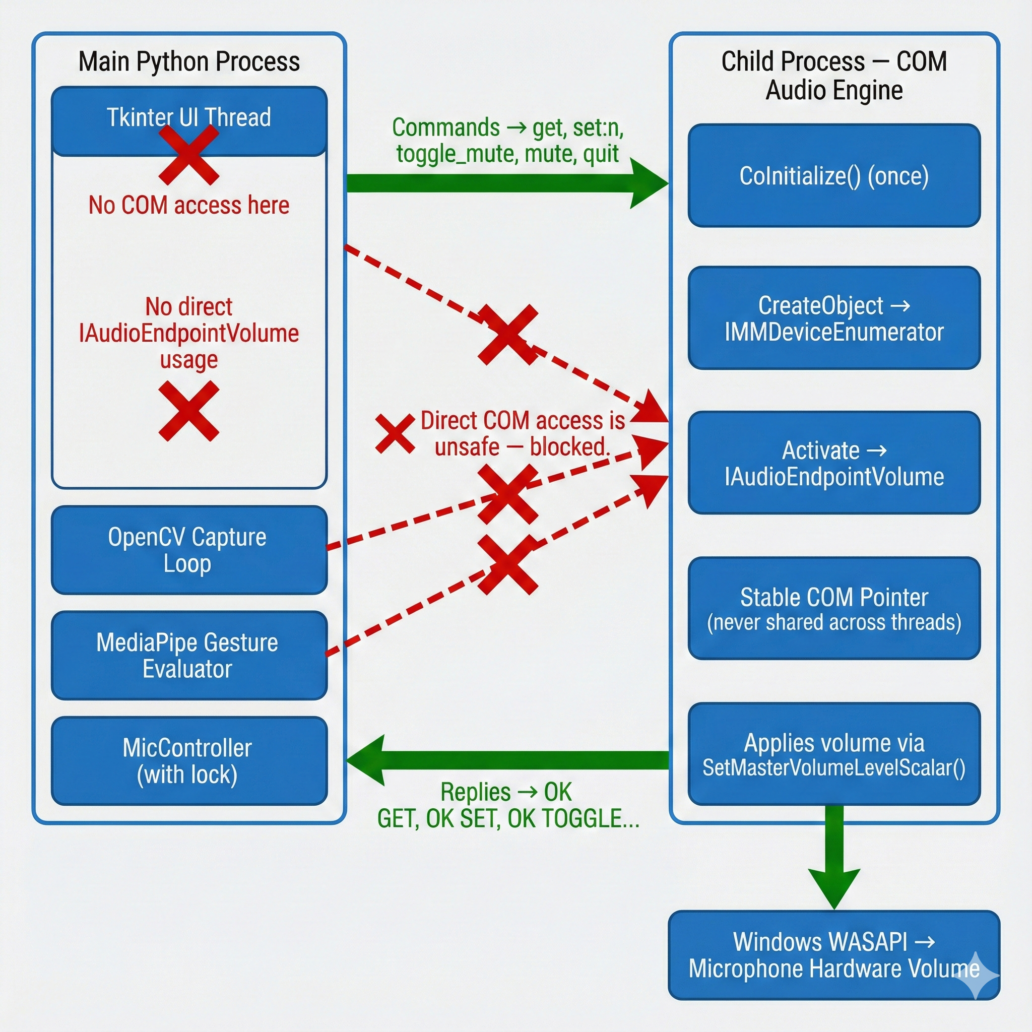
Why COM Must Be Initialized ONLY in the Child
COM follows a strict rule:
One COM initialization per thread, matched symmetrically with uninitialization.
Tkinter main thread and hotkey threads violate this rule by:
Reinitializing COM
Leaving orphaned COM contexts
Interfering with pycaw’s internal interfaces
Child process avoids this by:
Guaranteeing one thread
Guaranteeing one COM context
Guaranteeing controlled shutdown

Slide 24
Mic-Controller (Communication Layer)
The MicController acts as the “middle manager” between the UI/gesture logic and the child process that controls the microphone hardware. It abstracts inter-process communication into simple Python methods like:
get_volume()
set_volume(percent)
toggle_mute()
This allows the GUI and gesture system to interact with system-level audio without knowing anything about COM, Pycaw, or child-process internals.

Slide 25
Communication Pipeline Inside MicController
When a command is sent, MicController performs:
Acquire Lock: Ensures no two threads (UI, camera thread, hotkey handler) send commands simultaneously.
Write Command: Sends a clean text instruction ("get", "set:60") via stdin.
Flush Stream: Ensures the child receives the command instantly.
Wait for Reply: Uses a timeout loop (default 2 seconds) to fetch child’s response from the queue.
Return Parsed Value: Converts strings like "OK GET 42" → integer 42.
Error Handling: Detects timeouts, broken pipes, crashed child, or malformed responses.

Slide 26
The _send() Method
Core method:
def _send(self, line, timeout=2.0):
self.proc.stdin.write(line.strip() + "\n")
self.proc.stdin.flush()
# Wait for reply...
Key Behaviours:
Uses locking: prevents race conditions
Strips the command to avoid formatting issues
Flushes immediately (real-time behavior)
Reads from stdout via a queue (non-blocking child thread)
Retries until timeout expires (prevents freeze)
Why this matters: If _send() were not stable, GUI responsiveness would collapse.

Slide 27
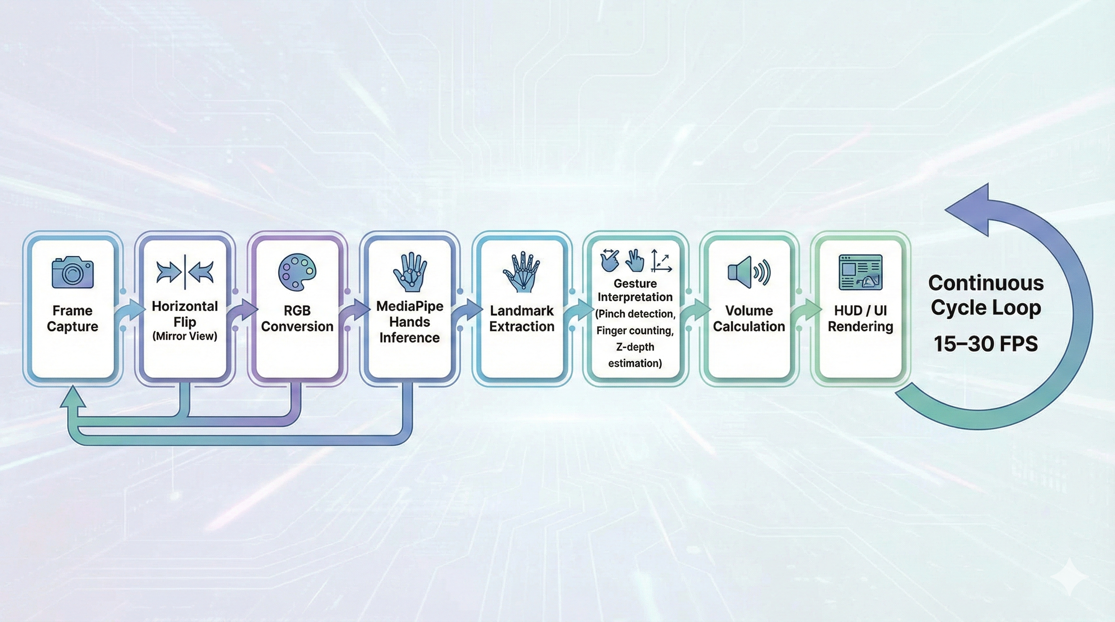
Gesture Processing Pipeline

Slide 28
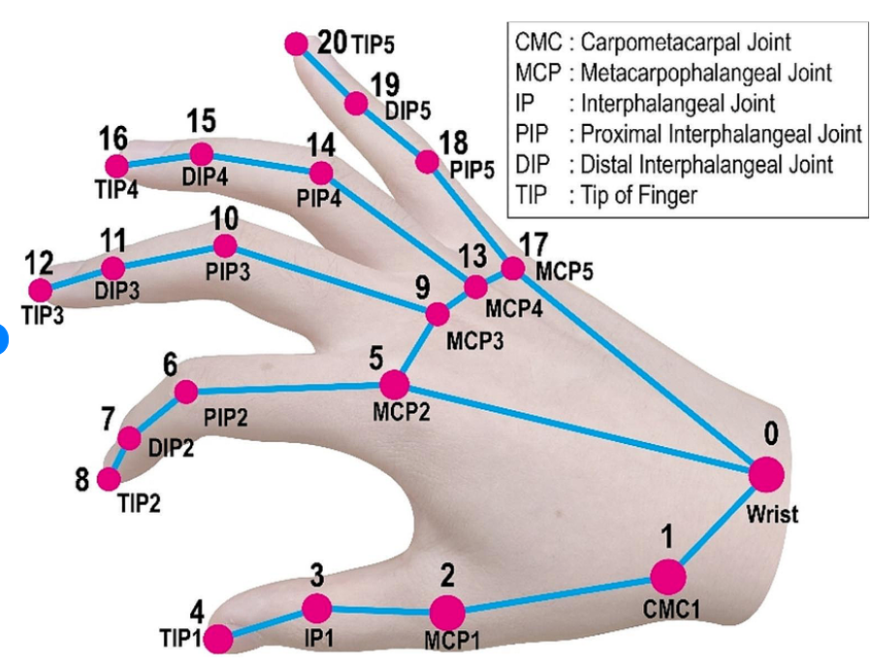
HAND LANDMARK WORKING IN GESTURE
Landmark Naming Convention
WRIST (0)
Base reference point of the hand
Finger Structure (Thumb, Index, Middle, Ring, Pinky):
MCP – Metacarpophalangeal (knuckle joint)
PIP – Proximal Interphalangeal (middle joint)
DIP – Distal Interphalangeal (joint near fingertip)
TIP – Fingertip
Example:
INDEX_FINGER_TIP (8)
THUMB_TIP (4) → used for pinch detection

Slide 29
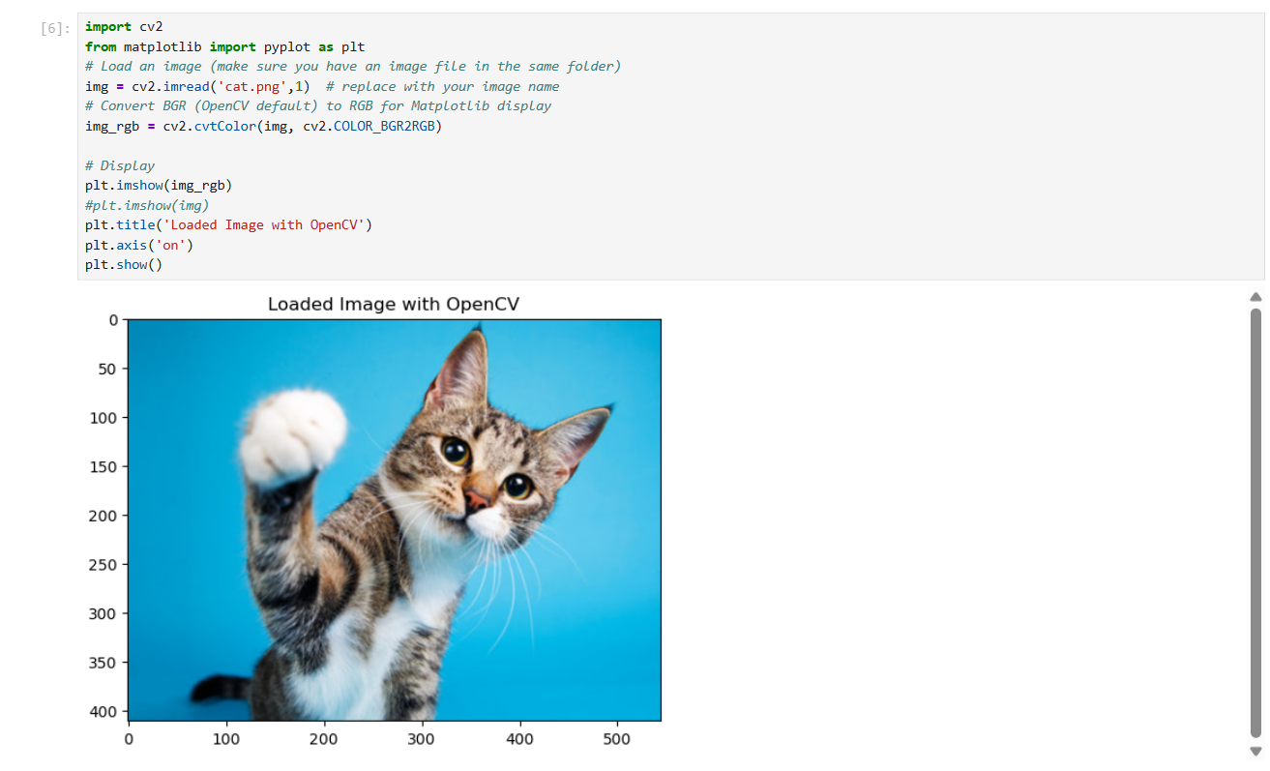
Load and Display Image
Commands used:-
cv2.imread(path, flag): reads the image from disk.
plt.imshow():- displays an image in Jupyter notebooks.
plt.axis('off') removes axis

Slide 30
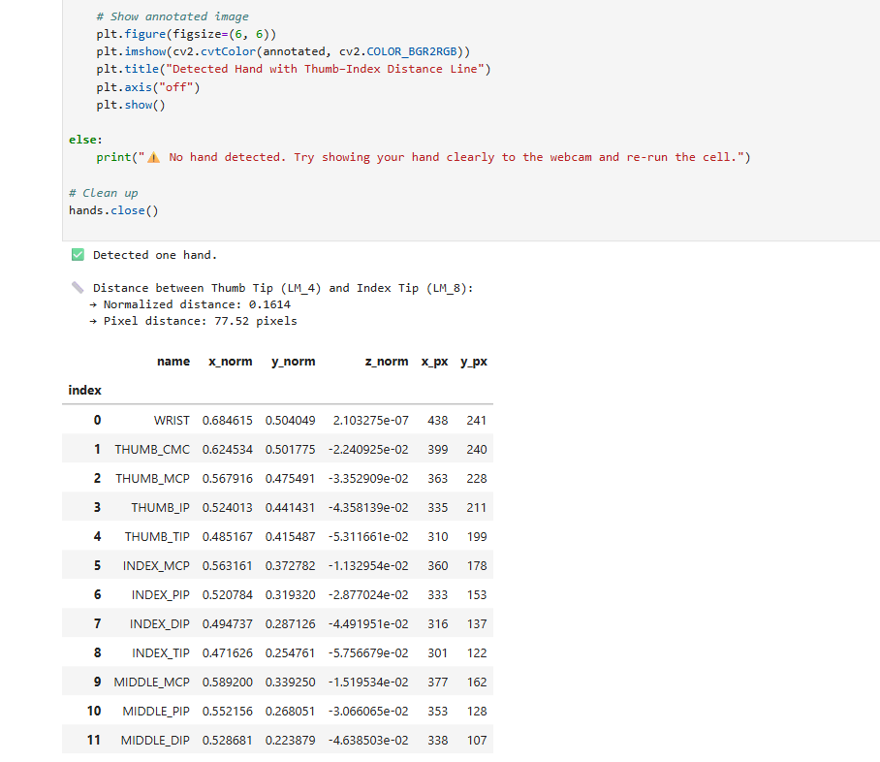
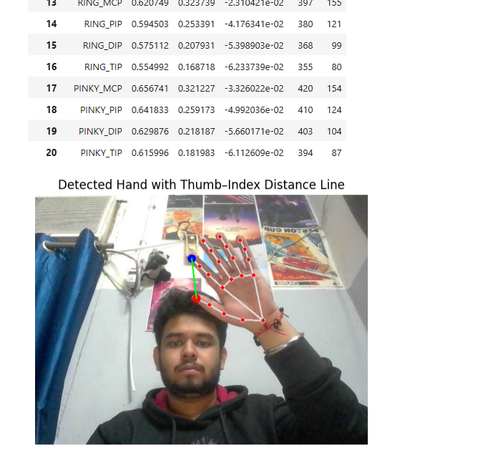
Index tip and thumb tip distance

Slide 31
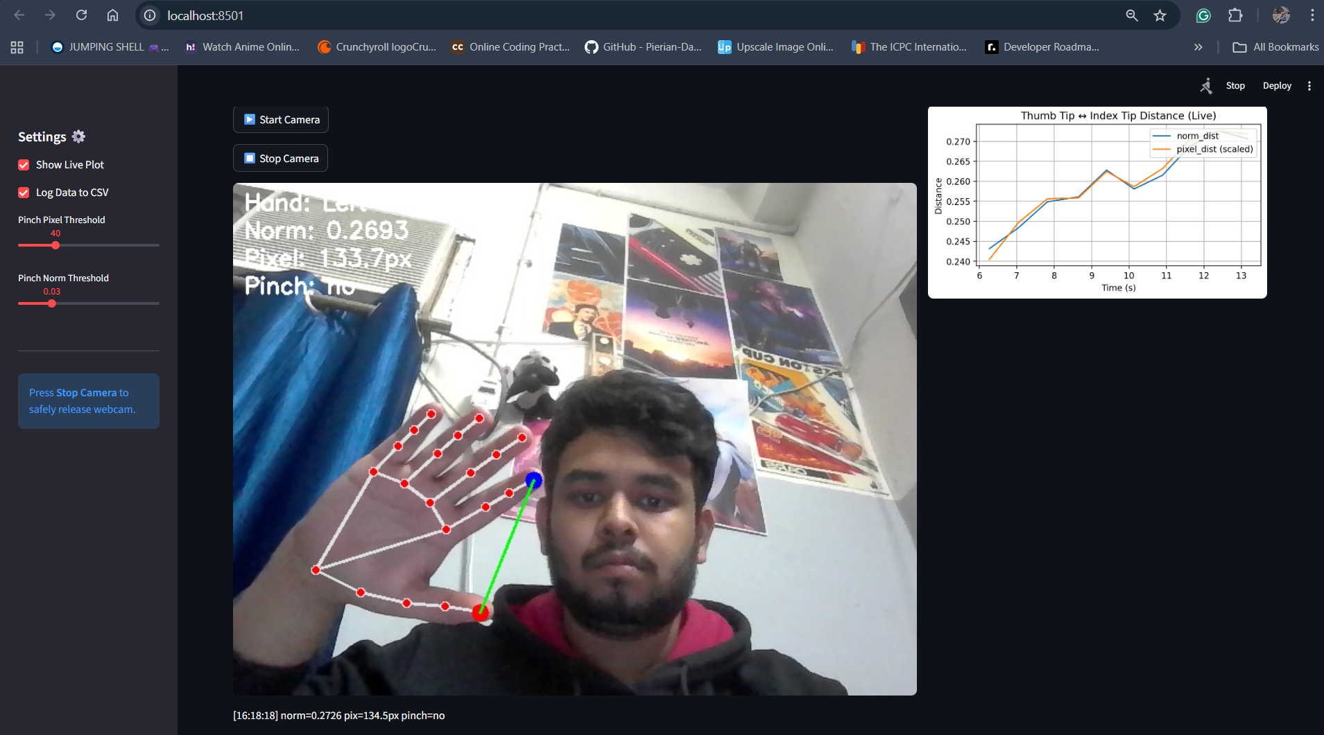
Live demo on streamlit

Slide 32
Why not Streamlit?
1) Real-time video & UI responsiveness
Tkinter runs in a single native window and renders frames directly (via PhotoImage/PIL). That minimizes latency and gives deterministic refresh timing for 20–30 FPS video.
Streamlit is web-based (browser refresh, websockets). Even with st.image updates, the browser roundtrip and network stack add latency and jitter — bad for smooth gesture control.
2) Native event loop & precise threading control
Tkinter mainloop is synchronous and predictable; you can schedule updates with root.after() and safely coordinate reader threads (OpenCV, child I/O).
Streamlit abstracts away the loop; callbacks rerun entire scripts and are not designed for long-running tight-loops or mixing native threads and blocking COM calls.

Slide 33
Why not Streamlit?
3) Easier, safer integration with COM / pycaw (child process pattern)
Tkinter accepts the child-process + stdin/stdout pattern cleanly. You keep COM calls local to a process and update the UI from the parent. The desktop environment avoids cross-process web security and marshalling concerns.
Streamlit would require the server to manage COM and then stream status to browser clients — trickier to debug and more fragile if clients disconnect.
4) Low overhead, single executable packaging
Tkinter apps are trivial to bundle into a single Windows executable (PyInstaller) that includes OpenCV, MediaPipe, and the child script.
Streamlit needs a server + browser; packaging and distribution become heavier and more awkward for offline demos.

Slide 34
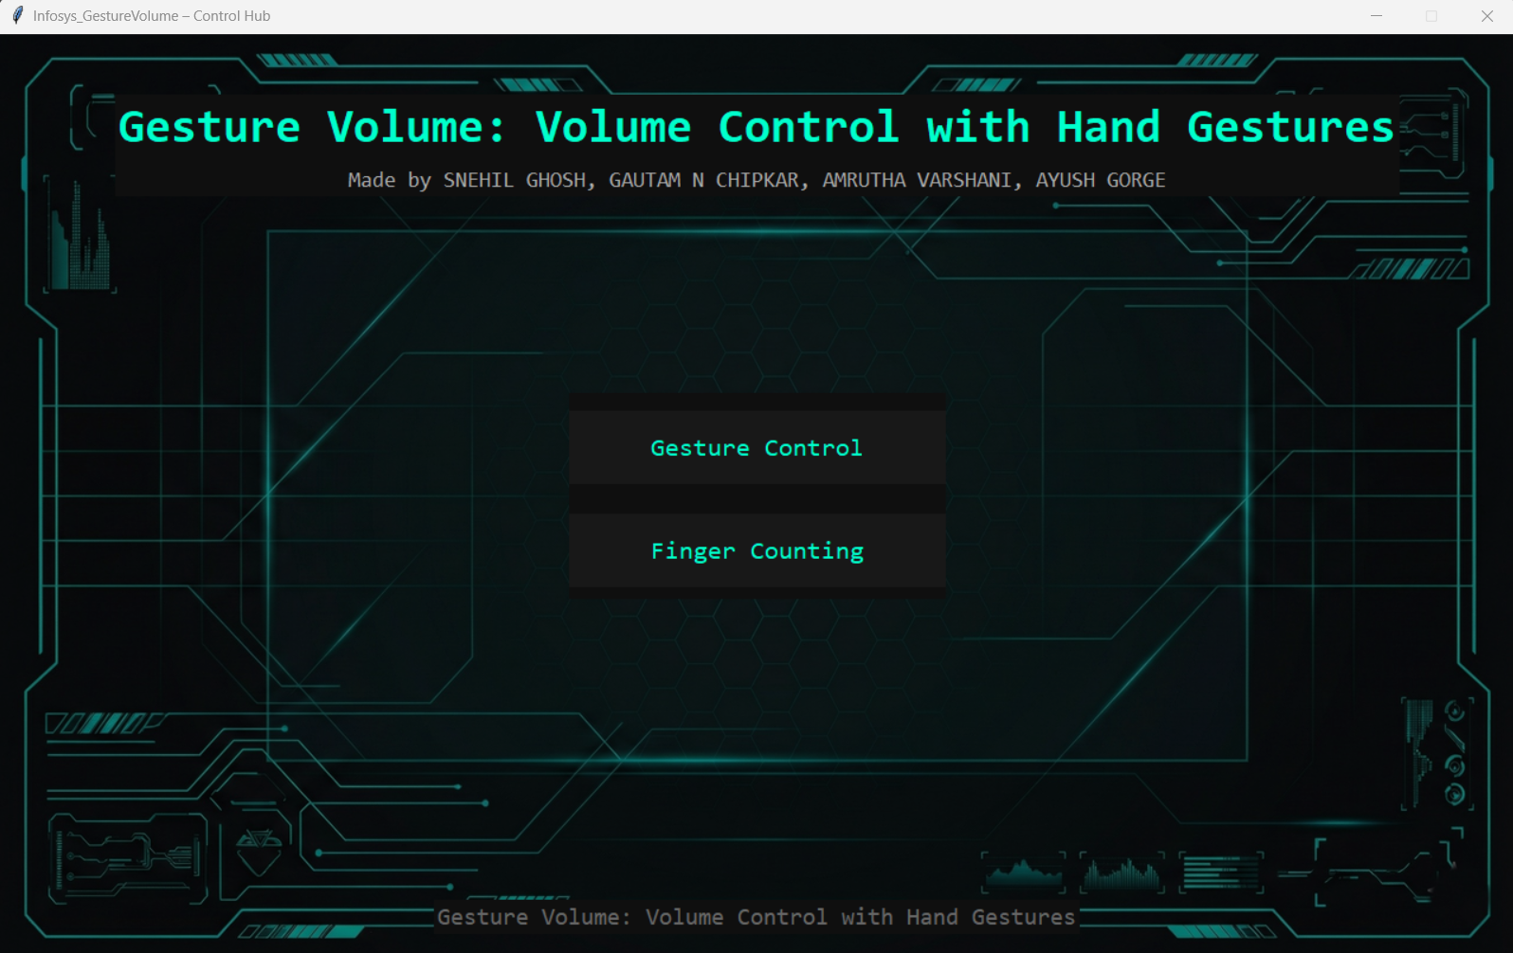
GUI

Slide 35
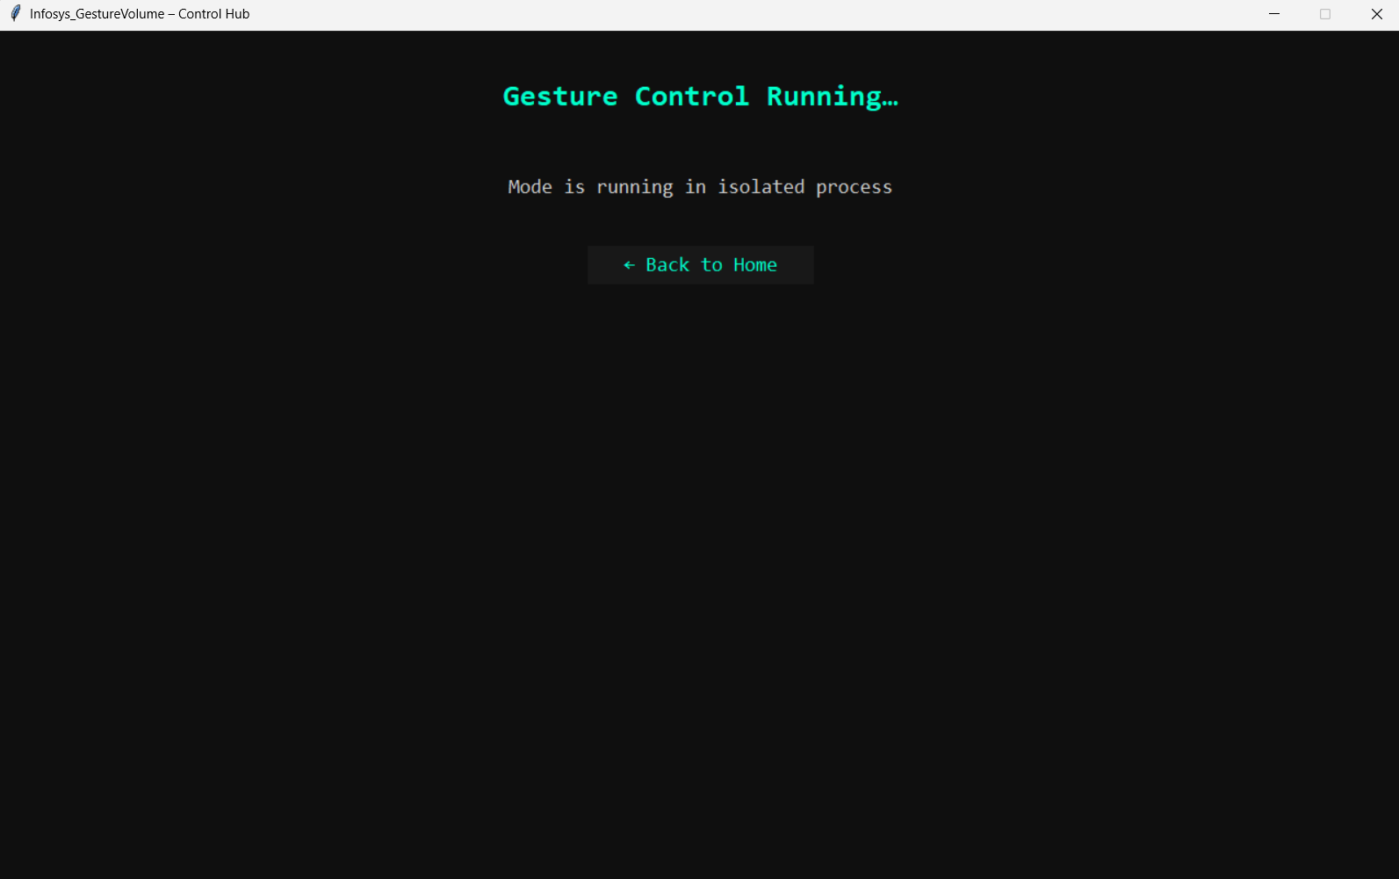
GUI

Slide 36
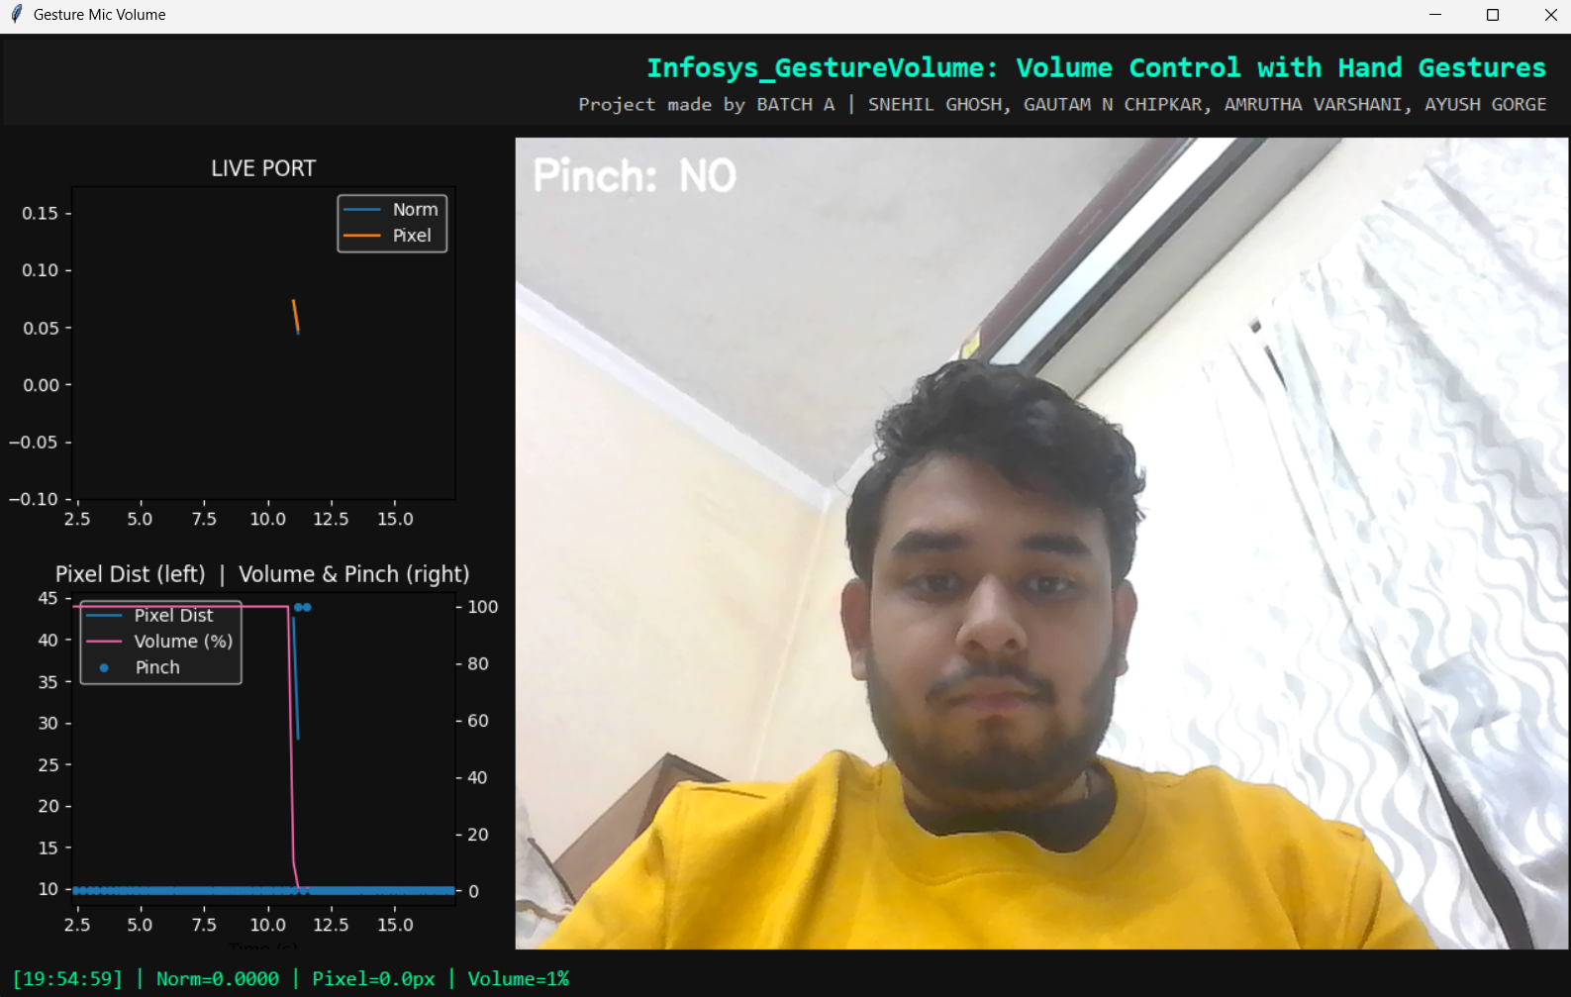
GUI

Slide 37
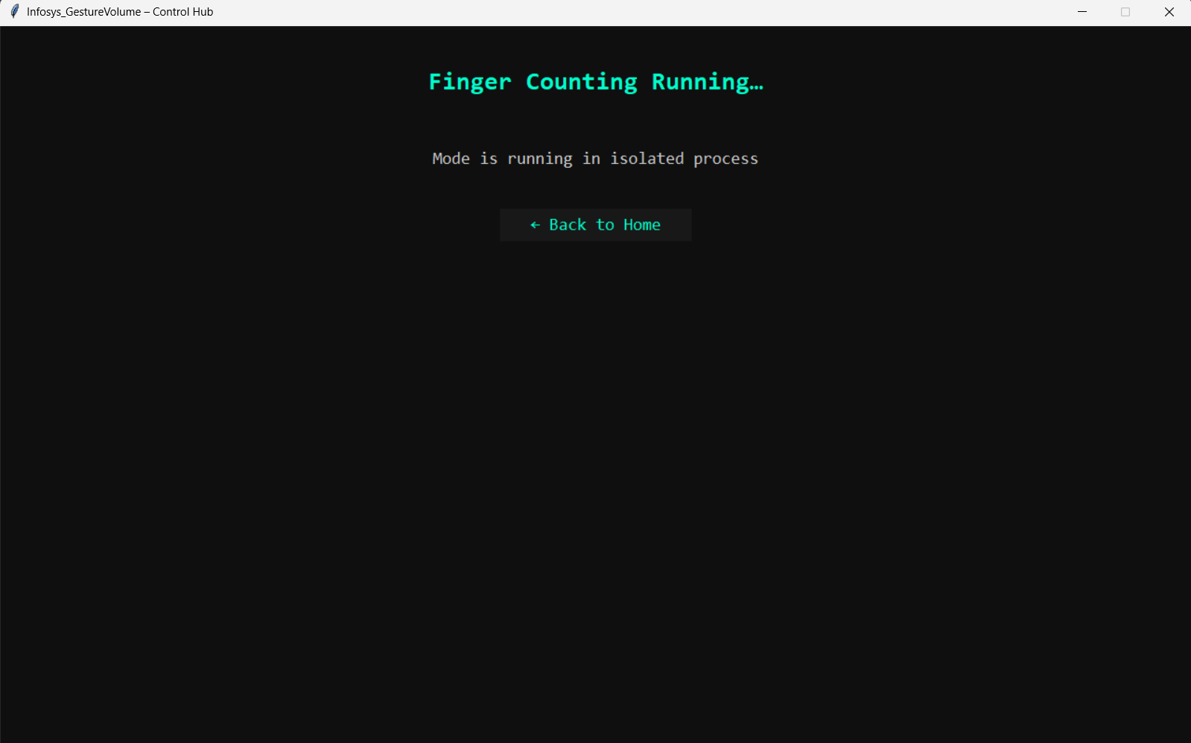
GUI

Slide 38
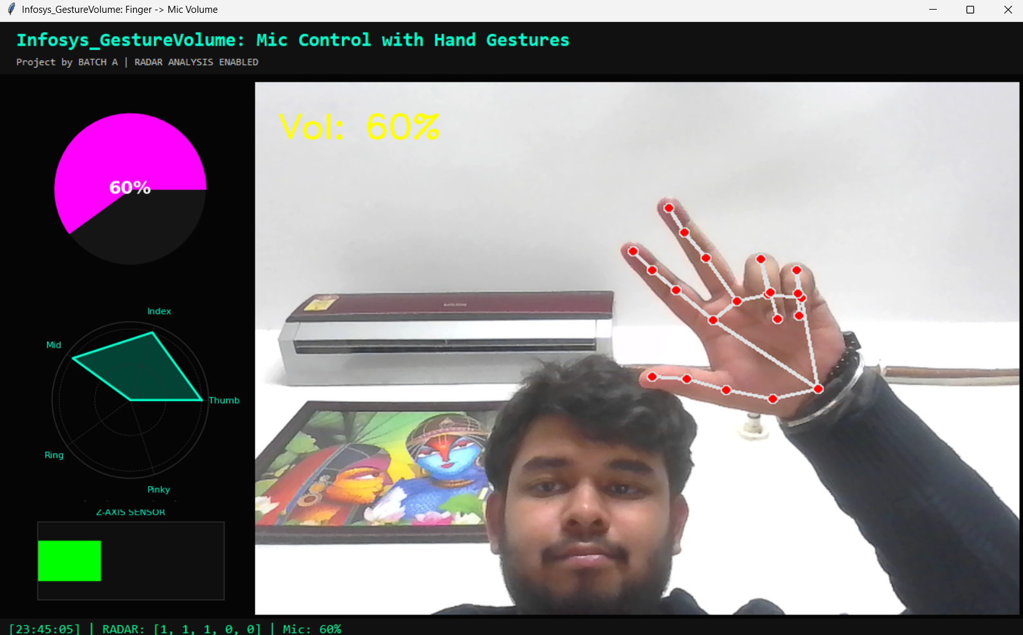
GUI

Slide 39
Thank you

